Slide 1
Browser Capabilities
Designing for consistent appearance

Slide 2
Browsers Differ
Even though browsers are moving to a consistent implementation of HTML, they differ in display and adherence.
It is your responsibility to make sure your page works for a wide audience.

Slide 3
Handling Stylistic Differences
“Easiest” way to eliminate browser differences is to use a default style sheet
Default style sheets reset all of the values for the page
Will make your page look worse!

Slide 4
Handling Unsupported Properties
Not all browsers support all HTML5 tags
Not all browsers support all CSS3 properties
Browser prefixes (or vendor prefixes) provide a quick fix for handling unsupported CSS3 options.

Slide 5
Browser Prefixes
-webkit-: Android, Chrome, iOS, Safari
-moz-: Firefox
-ms-: Internet Explorer
-o-: Opera

Slide 6
Often Unsupported Properties
column-count
border-radius**
gradient
Sites such as http://caniuse.com/ will tell you when you need to use prefixes

Slide 7
Automated Ways to include Prefixes
For now, add the prefixes by hand
There are ways to automate the addition of prefixes
Editor add-ons (You have most of the control)
Use outside programs to dynamically add appropriate prefix based on browser

Slide 8
Transforms

Slide 9
Transforms
Provide option for changing the appearance of elements
Two-dimensional
Three-dimensional

Slide 10
2D Transform Options
Options
translate
rotate
scale
skew
matrix

Slide 11


translate
transform:translate(x, y);
move x pixels to the left/right and y pixel up/down
transform:translate(100, 75);

Slide 12

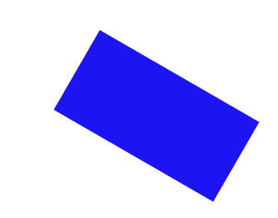
rotate
transform:rotate(deg);
Rotate/”spin” the element a certain number of degrees
transform:rotate(30deg);

Slide 13


scale
transform:scale(width, height);
Change the width and height of the element
transform:scale(2,3);

Slide 14


skew
transform:skew(x-angle, y-angle);
Rotate the element a certain number of degrees along the x and y axis
transform:skew(30deg, 15deg)

Slide 15
matrix
matrix() - combines all of the 2D transform methods into one

Slide 16
3D rotate
You can rotate along the x, y, or z dimension along a given degree
transform:rotateY(deg)
transform:rotateX(deg)
transform:rotateZ(deg)
transform:rotate3d(x, y, z)

Slide 17
Others
3D scale
3D translate

Slide 18
Review
Transforms are one more way to modify the look of your page.
Often combined with state changes
Will typically require browser prefixes.

Slide 19
Transitions

Slide 20
Transitions
When elements transition from one state to another, you can alter their appearance
If you hover over the link, change the color
If an image comes into focus, change the size,

Slide 21
The Properties
transition-property
What is it you want to change? (size, color, position, etc.)
transition-duration
How long should each transition last?
transition-timing
Should it be a smooth transition (linear)? Or different?
transition-delay
How long should the wait be before the transition begins?

Slide 22
Setting up
Define your element
Choose the elements for transition
Define the new values
You must combine this step with a pseudo-class

Slide 23
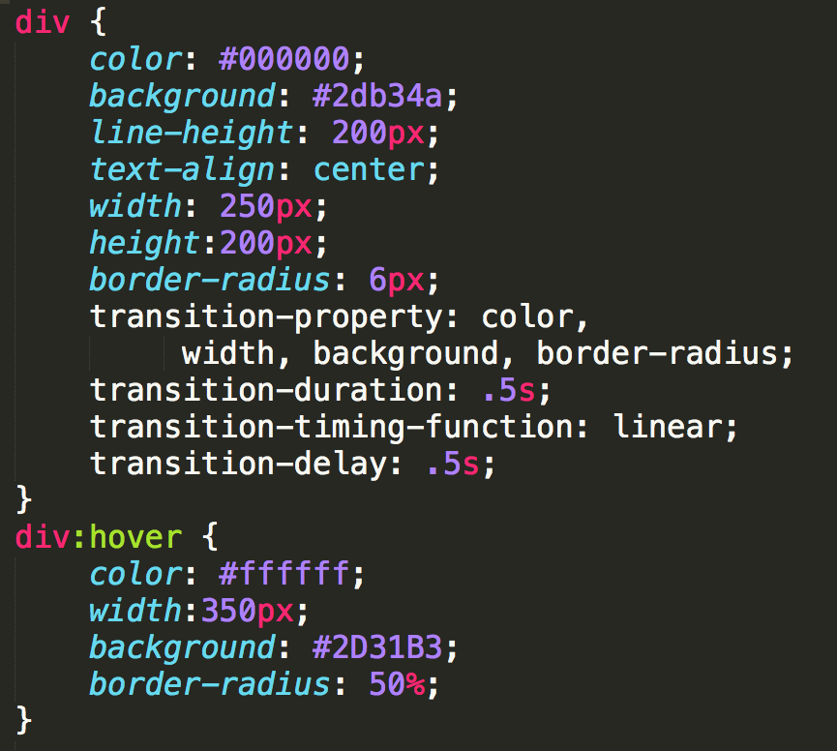
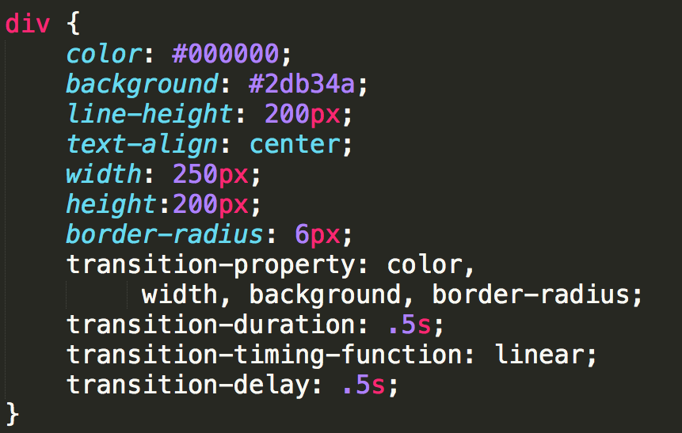
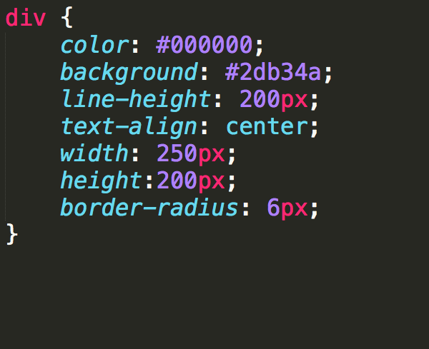
Example (CSS3-transitions)

Slide 24
Using Shorthands
If you have multiple properties transitioning, you can use shorthand:
transition:background .2s linear,
border-radius 1s ease-in 1s;

Slide 25
Examples
https://codepen.io/ColleenEMc/pen/zvPpRL
https://codepen.io/ColleenEMc/pen/YyEYem?editors=1100

Slide 26
Acknowledgements
These slides are Copyright 2019- Colleen van and made available under a Creative Commons Attribution 4.0 License. Please maintain this last slide in all copies of the document to comply with the attribution requirements of the license. If you make a change, feel free to add your name and organization to the list of contributors on this page as you republish the materials.
Initial Development: Colleen van Lent , University of Michigan School of Information

